Slide 1
Unit 4
Unsupervised Learning
Prepared By
Arjun Singh Saud, Asst. Prof. CDCSIT

Slide 2
Clustering
The process of grouping a set of physical or abstract objects into classes of similar objects is called clustering. It is an unsupervised learning technique.
A cluster is a collection of data objects that are similar to one another within the same cluster and are dissimilar to the objects in other clusters.
Clustering can also be used for outlier detection, where outliers may be more interesting than common cases.

Slide 3
Clustering
Applications of outlier detection include the detection of credit card fraud and the monitoring of criminal activities in electronic commerce.
For example, exceptional cases in credit card transactions, such as very expensive and frequent purchases, may be of interest as possible fraudulent activity.

Slide 4
Similarity and Dissimilarity
Distance measures are used in order to find similarity or dissimilarity between data objects.
The most popular distance measure is Euclidean distance, which is defined as:
Where,
Another well-known metric is Manhattan (or city block) distance, defined as

Slide 5
Similarity and Dissimilarity
Minkowski distance is a generalization of both Euclidean distance and Manhattan distance. It is defined as
Where p is a positive integer, such a distance is also called L_{p} norm, in some literature. It represents the Manhattan distance when p = 1 (i.e., L₁ norm) and Euclidean distance when p = 2 (i.e., L₂ norm).

Slide 6
Categories of Clustering Algorithms
Many clustering algorithms exist in the literature. In general, the major clustering methods can be classified into the following categories.
Partitioning Methods
Given a database of n objects or data tuples, a partitioning method constructs k partitions of the data, where each partition represents a cluster and k <n.
Given k, the number of partitions to construct, a partitioning method creates an initial partitioning. It then uses an iterative relocation technique that attempts to improve the partitioning by moving objects from one group to another.

Slide 7
Categories of Clustering Algorithms
Hierarchical Methods
A hierarchical method creates a hierarchical decomposition of the given set of data objects. A hierarchical method can be classified as being either agglomerative or divisive.
The agglomerative approach follows the bottom-up approach. It starts with each object forming a separate group. It successively merges the objects or groups that are close to one another, until a termination condition holds.
The divisive approach follows the top-down approach. It starts with all of the objects in the same cluster. In each successive iteration, a cluster is split up into smaller clusters, until a termination condition holds.

Slide 8
Categories of Clustering Algorithms
Density-based Methods
Most partitioning methods cluster objects based on the distance between objects. Such methods can find only spherical-shaped clusters and encounter difficulty at discovering clusters of arbitrary shapes.
Other clustering methods have been developed based on the notion of density. Their general idea is to continue growing the given cluster as long as the density (number of objects or data points) in the neighborhood exceeds some threshold.

Slide 9
Categories of Clustering Algorithms
Model-based Methods
Model-based methods hypothesize a model for each of the clusters and find the best fit of the data to the given model.
EM is an algorithm that performs expectation-maximization analysis based on statistical modeling.

Slide 10
K-Means Algorithm
K-means is one of the simplest partitioning based clustering algorithm. The procedure follows a simple and easy way to classify a given data set into a certain number of clusters (assume k clusters) fixed Apriori.
The main idea is to define k centers, one for each cluster. These centers should be selected cleverly because of different location causes different result. So, the better choice is to place them as much as possible far away from each other.

Slide 11
K-Means Algorithm
Initialize cluster centroids μ₁, μ₂, . . . , μ_{k} belonging to data points randomly.
Repeat Until Convergence
{
For every i, set
for every j, set
}

Slide 12
K-Means Algorithm
Example: Divide the data points {(2,10), ((2,5), (8,4), (5,8), (7,5), (6,4)} into two clusters.
Solution
Let p1=(2,10) p2=(2,5) p3=(8,4) p4=(5,8) p5=(7,5) p6=(6,4)
Initial step
Choose Cluster centers randomly
Let μ₁ =(2,5) and μ₂ =(6,4) are two initial cluster centers.

Slide 13
K-Means Algorithm
Iteration 1: Calculate distance between clusters centers and each data points
d(μ₁,p₁)=5 d(μ₂,p₁)=7.21
d(μ₁,p₂)=0 d(μ₂,p₂)=4.12
d(μ₁,p₃)=6.08 d(μ₂,p₃)=2
d(μ₁,p₄)=4.24 d(μ₂,p₄)=4.12
d(μ₁,p₅)=5 d(μ₂,p₅)=1.41
d(μ₁,p₆)=4.12 d(μ₂,p₆)=0
Thus, Cluster1={p1,p2} cluster2={p3,p4,p5,p6}

Slide 14
K-Means Algorithm
Iteration 2: New Cluster centers: μ₁ =(2,7.5) μ₂ =(6.5,5.25)
d(μ₁,p₁)=2.5 d(μ₂,p₁)=6.54
d(μ₁,p₂)=2.5 d(μ₂,p₂)=4.51
d(μ₁,p₃)=6.95 d(μ₂,p₃)=1.95
d(μ₁,p₄)=3.04 d(μ₂,p₄)=3.13
d(μ₁,p₅)=4.59 d(μ₂,p₅)= 0.56
d(μ₁,p₆)= 5.32 d(μ₂,p₆)=1.35
Thus, Cluster1={p1,p2,p4} cluster2={p3,p5,p6}

Slide 15
K-Means Algorithm
Iteration 3: New Cluster centers: μ₁ = (3,7.67) μ₂ ==(7,4.33)
d(μ₁,p₁)=2.54 d(μ₂,p₁)=7.56
d(μ₁,p₂)=2.85 d(μ₂,p₂)=5.04
d(μ₁,p₃)=6.2 d(μ₂,p₃)=1.05
d(μ₁,p₄)=2.03 d(μ₂,p₄)=4.18
d(μ₁,p₅)=4.81 d(μ₂,p₅)= 0.67
d(μ₁,p₆)= 4.74 d(μ₂,p₆)=1.05
Thus, Cluster1={p1,p2,p4} cluster2={p3,p5,p6}

Slide 16
K-Means Algorithm
Since, No data points are re-assigned
Final clusters are: Cluster1={p1,p2,p4} cluster2={p3,p5,p6}

Slide 17
K-Means++ Algorithm
Randomization of picking k cluster centers in K-means algorithm results in the problem of initialization sensitivity.
This problem tends to affect the final formed clusters. The final formed clusters depend on how initial cluster centers were picked.
To overcome the above-mentioned drawback we use K-means++. This algorithm ensures a smarter initialization of the cluster centers and improves the quality of the clustering.
Apart from initialization, the rest of the algorithm is the same as the standard K-means algorithm.

Slide 18
K-Means++ Algorithm
Initialization Algorithm
Randomly select the first cluster center from the data points.
For each data point compute its distance from the nearest, previously chosen cluster center.
Select the next cluster center from the data points such that the probability of choosing a point as cluster center is directly proportional to its distance from the nearest, previously chosen cluster center.
Repeat steps 2 and 3 until K cluster centers have been sampled

Slide 19
K-Means++ Algorithm
Example: Consider the data points {(2,10), ((2,5), (8,4), (5,8), (7,5), (6,4),(3,2),(4,6)}. Select three cluster centers using K-means++ algorithm. Select data point with highest probability as next cluster center.
Solution
Let p1=(2,10) p2=(2,5) p3=(8,4) p4=(5,8) p5=(7,5) p6=(6,4) p7=(3,2) p8=(4,6)
Select the first cluster center randomly. Let μ₁ =(2,5)
d(μ₁,p1)=5 d(μ₁,p2)=0 d(μ₁,p3)=6.08 d(μ₁,p4)=4.24
d(μ₁,p5)=5 d(μ₁,p6)=4.12 d(μ₁,p7)=3.6 d(μ₁,p8)=2.12

Slide 20
K-Means++ Algorithm
Thus, probabilities of data points being selected as next cluster center is directly proportional to:{5,0,6.08,4.24,5,4.12,3.6,2.12}
The data point p3=(8,4) has the highest probability of being selected as cluster center. Thus, μ₂ =p3=(8,4)
Again, for each data point compute its distance from the nearest cluster center:
min(d(μ₁,p1), d(μ₂,p1))=5 min(d(μ₁,p2), d(μ₂,p2))=0
min(d(μ₁,p3), d(μ₂,p3))=0 min(d(μ₁,p4), d(μ₂,p4))=4.24
min(d(μ₁,p5), d(μ₂,p5))=5 min(d(μ₁,p6), d(μ₂,p6))=4.12
min(d(μ₁,p7), d(μ₂,p7))=5.39 min(d(μ₁,p8), d(μ₂,p8))=4.47

Slide 21
K-Means++ Algorithm
The data point p7=(3,2) has the highest probability of being selected as next cluster center.
Thus three cluster centers are: μ₁ =(2,5) μ₂=(8,4), μ₂=(3,2)

Slide 22
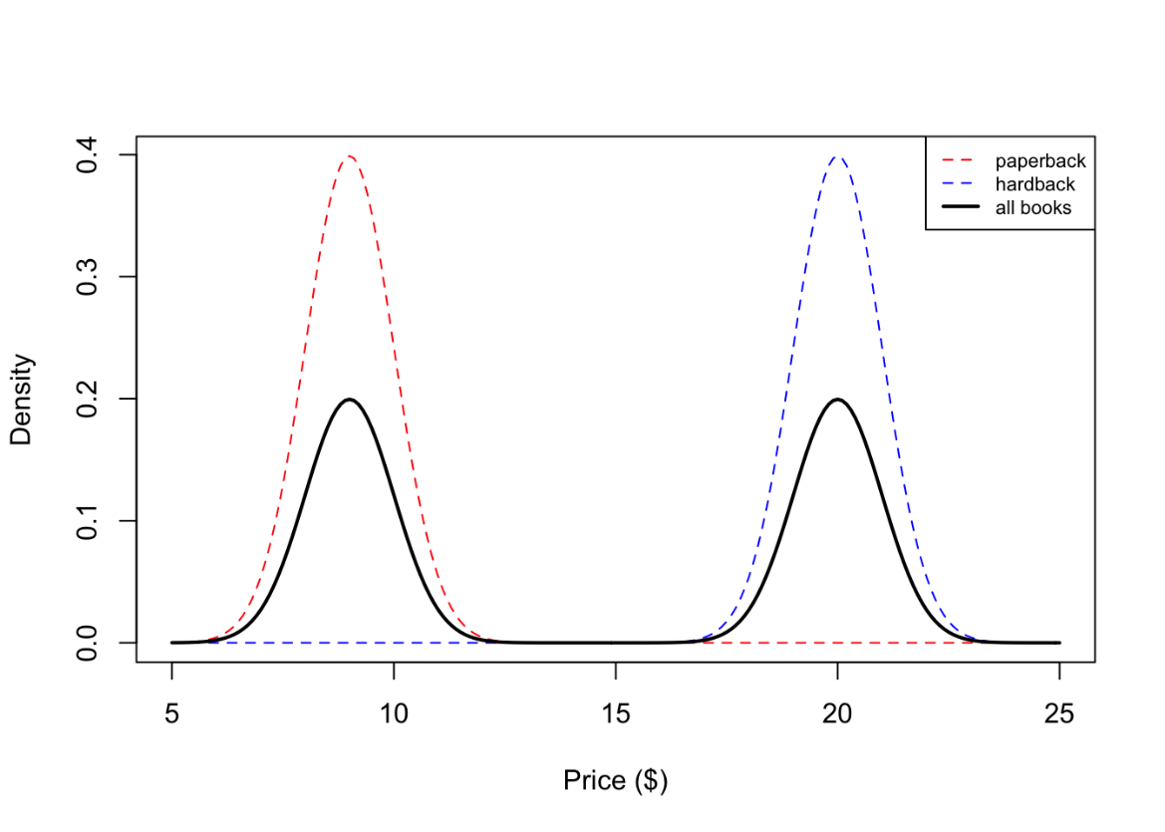
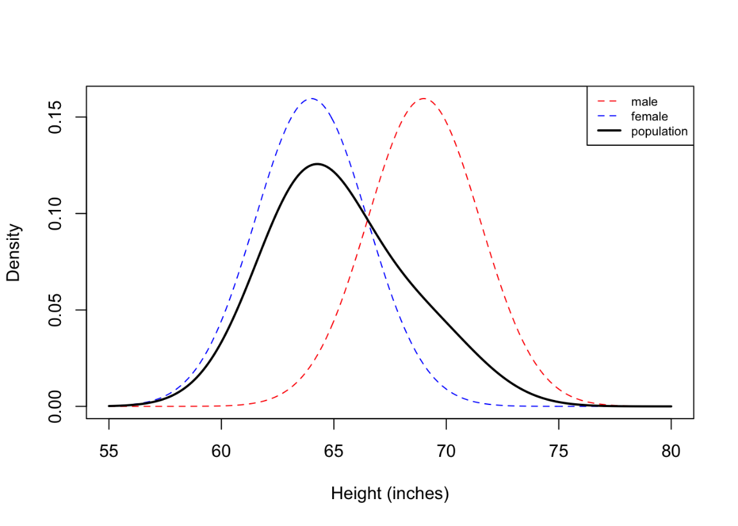
Gaussian Mixture Models and EM
If we model data points using mixture of two or more components where each component is modeled as a Gaussian distribution, it is called a Gaussian mixture model (GMM).

Slide 23
Gaussian Mixture Models and EM
Partition, hierarchical, and density based clustering methods are hard clustering algorithms. This means these algorithms assigns every data object to exactly one cluster.
Gaussian Mixture Model (GMM) is soft clustering algorithm. It may assigns data object to multiple clusters with some probability.
For example, if k=3, a data point can be assigned to clusters c1 and c2 with probabilities 0.7 and 0.3 respectively.

Slide 24
Gaussian Mixture Models and EM
Gaussian Mixture Models (GMMs) assume that there are a certain number of Gaussian distributions, and each of these distributions represent a cluster.
Hence, a Gaussian Mixture Model tends to group the data points belonging to a single distribution together.
For a given set of data points, our GMM would identify the probability of each data point belonging to each of these distributions.

Slide 25
Gaussian Mixture Models and EM
Assume we observe height {x₁,…,x_{n}}and that each x_{i} is sampled from one of K mixture components. Suppose, the mixture components are {male, female}.
Moreover, z_{i}∈{1,…,k} is a label associated with each random variable x_{i} which indicates the component from the variable x_{i} Came from.
Here, z_{i} would be either 1 or 2 depending on whether x_{i} was a male or female height. Normally, we don’t observe z_{i} (i.e. we might just obtain a list of heights with no gender information), so the z_{i}’s are sometimes called latent variables.

Slide 26
Gaussian Mixture Models and EM
From the law of total probability, we know that the probability of x_{i} is:
Here, the p_{k} are called mixture proportions or mixture weights and they represent the probability that x_{i} belongs to the k^{th} mixture component.

Slide 27
Gaussian Mixture Models and EM
The mixture proportions are nonnegative and they sum to one. f(x_{i}) is a mixture component, and it represents the distribution of x_{i} assuming it came from component k.
GMM is a kind of statistical model that involves latent variables and hence can not be solved using MLE method.
Expectation maximization (EM) algorithm is a method to find MLE of the parameters of a statistical model involving latent variables.

Slide 28
Gaussian Mixture Models and EM
Outline of EM Algorithm
Initialize the μ_{k}’s, σ_{k}’s and p_{k}’s and evaluate the log-likelihood of these parameters.
E-step: Evaluate the posterior probabilities γ_{zi}(k) using the current values of the μ_{k}’s and σ_{k}’s.
M-step: Estimate new parameters μ_{k}, σ_{k} and p_{k} with the current values of γ_{zi}(k).
Evaluate the log-likelihood of new μ_{k}’s, σ_{k}’s and p_{k}’s.
If the log-likelihood is changed by less than some small ϵ, stop. Otherwise, go back to step 2.

Slide 29
Gaussian Mixture Models and EM
EM for GMM
Suppose we are given a set of m data observations{x₁,x₂,...,x_{m}} of a numerical variable X. Let X be a mix of k normal distributions.
Now GMM is mixture of k probability distributions:

Slide 30
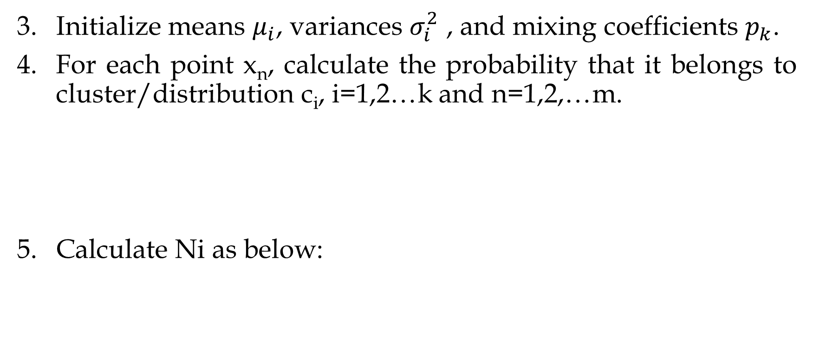
Gaussian Mixture Models and EM
Initialize means $μ_{i}$, variances $σ_{i}^{2}$ , and mixing coefficients $p_{k}$.
For each point x_{n}, calculate the probability that it belongs to cluster/distribution c_{i}, i=1,2…k and n=1,2,…m.
Calculate Ni as below:

Slide 31
Gaussian Mixture Models and EM
Recalculate parameters as below
Check for convergence. If converge, stop. Otherwise repeat steps 4-6.

Slide 32
Gaussian Mixture Models and EM
Example
We have divide the data points {1,2,3,6,10,11,12} into two clusters using GMM. Estimate parameters up to 2 iterations.
Solution
Let

Slide 33
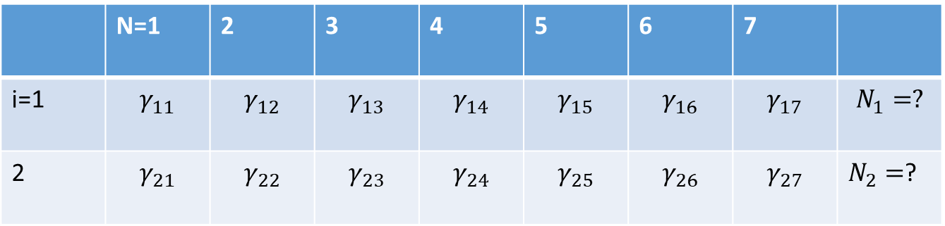
Gaussian Mixture Models and EM
Now,
 | N=1 | 2 | 3 | 4 | 5 | 6 | 7
i=1 | $$γ_{11}$$ | $$γ_{12}$$ | $$γ_{13}$$ | $$γ_{14}$$ | $$γ_{15}$$ | $$γ_{16}$$ | $$γ_{17}$$ | $$N_{1}=?$$
2 | $$γ_{21}$$ | $$γ_{22}$$ | $$γ_{23}$$ | $$γ_{24}$$ | $$γ_{25}$$ | $$γ_{26}$$ | $$γ_{27}$$ | $N_{2}=$?

Slide 34
Gaussian Mixture Models and EM
Multi-variate GMM
Suppose we are given a set of m data observations{(x₁,y₁), (x₂,y₂)..., (x_{m},y_{m})}. Let observations are a mix of k normal distributions.
Now GMM is mixture of k probability distributions:

Slide 35
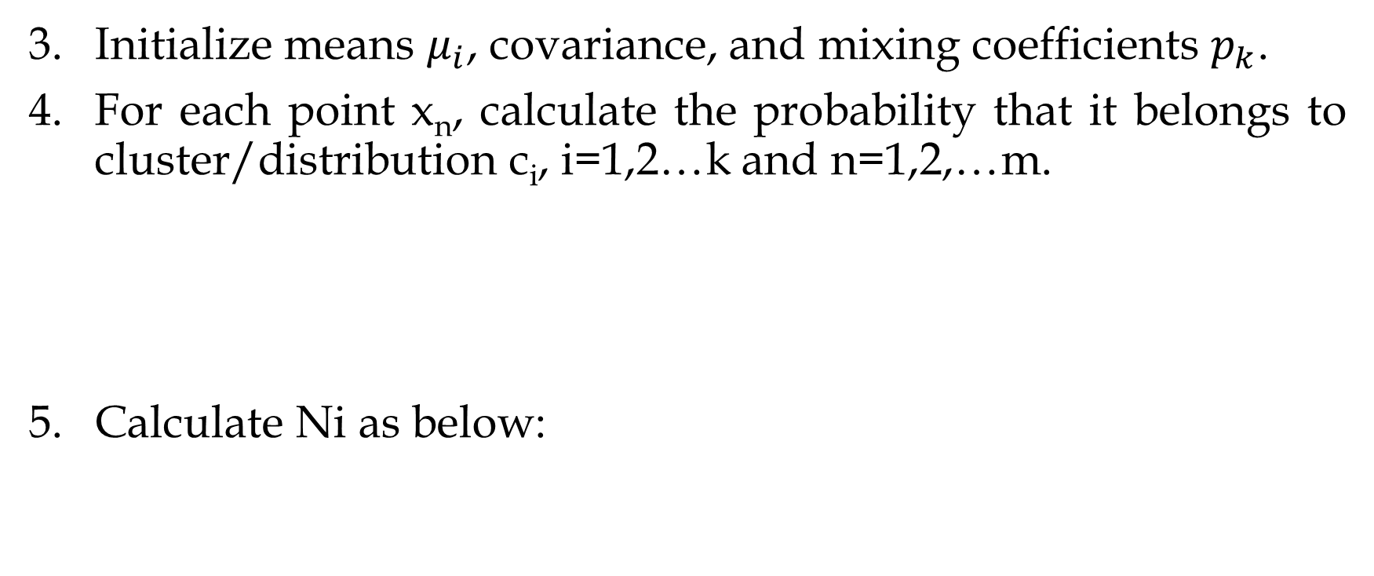
Gaussian Mixture Models and EM
Initialize means $μ_{i}$, covariance, and mixing coefficients $p_{k}$.
For each point x_{n}, calculate the probability that it belongs to cluster/distribution c_{i}, i=1,2…k and n=1,2,…m.
Calculate Ni as below:

Slide 36
Gaussian Mixture Models and EM
Recalculate parameters as below
Check for convergence. If converge, stop. Otherwise repeat steps 4-6.

Slide 37
Gaussian Mixture Models and EM
Example
We have divide the data points {(1,2),(2,3),(1,4),(2,6),(2,8),(3,7),(2,4)} into two clusters using GMM. Estimate parameters up to 1 iteration.
Solution

Slide 38
Text Clustering
Text clustering is the application of cluster analysis to text-based documents.
It uses machine learning and natural language processing (NLP) to understand and categorize unstructured, textual data.
Normally, following steps are followed in text clustering: Prepare Bag of Words, Remove stop words, Perform stemming, Calculate TF, Calculate IDF, Calculated TF-IDF, Use Clustering algorithm.

Slide 39
Text Clustering
Prepare Bag of Words
A bag of words is a representation of text that describes the occurrence of words within a document.
We just keep track of word counts and disregard the grammatical details and the word order.
It is called a “bag” of words because any information about the order or structure of words in the document is discarded.
The model is only concerned with whether a word occur in the document, not where in the document.

Slide 40
Text Clustering
Remove Stop Words
Stop word removal is one of the most commonly used preprocessing steps across different NLP applications. The idea is simply removing the words that occur commonly across all the documents in the corpus.
Typically, articles and pronouns are generally classified as stop words. Words such as “the”, “a”, “an”, “of”, etc. are stop words.
These words have no significance in some of the NLP tasks like information retrieval, classification and clustering, which means these words are not very discriminative. We would not want these words to take up space in our database, or taking up valuable processing time.

Slide 41
Text Clustering
Perform Word Stemming
The goal of both stemming and lemmatization is to reduce inflectional forms and sometimes derivationally related forms of a word to a common base form. For instance:
am, are, is => be car, cars, car's, cars‘ => car
The result of this mapping of text will be something like:
The boy's cars are different colors => the boy car be differ color
The most common algorithm for stemming English, and one that has repeatedly been shown to be empirically very effective, is Porter's algorithm.

Slide 42
Text Clustering
Calculated TF-IDF
Term Frequency (TF): The term frequency is simply the number of occurrences of a word in a specific document. The term frequencies are calculated per word and document.
Inverse Document Frequency (IDF): The inverse document frequency is a measure of whether a term is common or rare in a given document corpus. IDF is only calculated per word.

Slide 43
Text Clustering
TF-IDF: TF-IDF (term frequency-inverse document frequency) is a statistical measure that evaluates how relevant a word is to a document in a collection of documents.
This is done by multiplying two metrics: Term Frequency and Inverse Document Frequency.
TF-IDF=TF × IDF
Once we have document vectors we can use any clustering algorithm to perform documents clustering.

Slide 44
Text Clustering
Example: Computer TF-IDF vectors for following documents:
D1: Computer Science and Information Technology
D2: Computer Science and Engineering
D3: Humanities and Social Science
D4: Department of Social Science
D5: Applications of Computer Science
Solution:
Bag of words (BW)={Computer, Science, and, Information, Technology, Engineering, Humanities, Social, Science, Department, of, Applications}

Slide 45
Text Clustering
Bag of words (BW)={Computer, Science, and, Information, Technology, Engineering, Humanities, Social, Science, Department, of, Applications}

Slide 46
Dimensionality Reduction
Increasing the number of features will not always improve classification accuracy.
In practice, the inclusion of more features might actually lead to worse performance.
The number of training examples required increases exponentially with dimensionality d (i.e., k^{d}).
Therefore, we need to choose an optimum set of features to improve classification accuracy.

Slide 47
Dimensionality Reduction
Reducing the number of variables of a data set naturally comes at the expense of accuracy, but the trick in dimensionality reduction is to trade a little accuracy for simplicity.
Because smaller data sets are easier to explore and visualize and make analyzing data much easier and faster for machine learning algorithms without extraneous variables to process.

Slide 48
Dimensionality Reduction
Dimensionality reduction is the process of reducing the number of variables under consideration by obtaining smaller set of principle variables.
There are many ways to achieve dimensionality reduction, but most of these techniques fall into one of two classes:
Feature Elimination
Feature Extraction
Feature selection method selects k dimensions from set of d dimensions in the original dataset.

Slide 49
Dimensionality Reduction
In feature selection, we try to find a subset of the original set of variables, or features, to get a smaller subset which can be used to model the problem.
K<N

Slide 50
Dimensionality Reduction
Feature extraction: finds a set of new features through some mapping function f() from the existing features. The mapping f() could be linear or non-linear.
K<N

Slide 51
Dimensionality Reduction
The various feature extraction methods used for dimensionality reduction:
Principal Component Analysis (PCA)
Linear Discriminant Analysis (LDA)
Generalized Discriminant Analysis (GDA)

Slide 52
Dimensionality Reduction
Principle Component Analysis (PCA)
PCA is an unsupervised learning algorithm that is used for the dimensionality reduction in machine learning.
This method is often used to reduce the dimensionality of large data sets, by transforming a large set of variables into a smaller one that still contains most of the information in the large set.
It is a statistical process that converts the observations of correlated features into a set of linearly uncorrelated features with the help of orthogonal transformation.

Slide 53
Dimensionality Reduction
Principle Component Analysis (PCA)
These new transformed features are called the Principal Components (PCs). Some properties of these principal components are given below:
The PC must be the linear combination of the original features.
These components are orthogonal, i.e., the correlation between a pair of variables is zero.
The importance of each component decreases when going to 1 to n, it means the First PC has the most importance, and n^{th} PC will have the least importance.

Slide 54
Dimensionality Reduction
Working of PCA
Get the Dataset with k Features
Compute mean of the Dataset: compute mean of each feature.
x₁ | x₂ | ……… | x_{k}
x₁₁ | x₂₁ | ……… | x_{k1}
x₁₂ | x₂₂ | ……… | x_{k2}
……. | ……. | ……… | …….
x_{1n} | x_{2n} | ……… | x_{kn}

Slide 55
Dimensionality Reduction
Working of PCA
Compute Correlation matrix of each feature pair

Slide 56
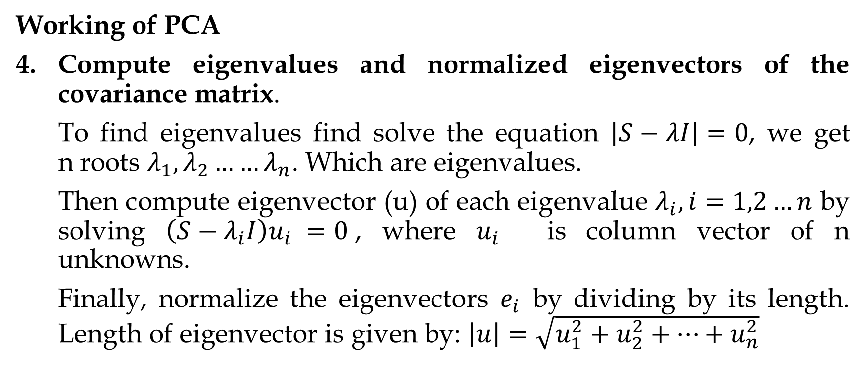
Dimensionality Reduction
Working of PCA
Compute eigenvalues and normalized eigenvectors of the covariance matrix.
To find eigenvalues find solve the equation $\left|S−λI\right|=0$, we get n roots $λ_{1},λ_{2}……λ_{n}$. Which are eigenvalues.
Then compute eigenvector (u) of each eigenvalue $λ_{i}, i=1,2…n$ by solving $\left(S−λ_{i}I\right)u_{i} =0$, where $u_{i}$ is column vector of n unknowns.
Finally, normalize the eigenvectors $e_{i}$ by dividing by its length. Length of eigenvector is given by: $\left|u\right|=\sqrt{u_{1}^{2}+u_{2}^{2}+…+u_{n}^{2}}$

Slide 57
Dimensionality Reduction
Working of PCA
The normalized eigenvector corresponding to the largest eigenvalue is the first principle component.
Derive new dataset by using most important m principle components.
PC₁ | PC₂ | ……… | PC_{m}
p₁₁ | p₂₁ | ……… | p_{m1}
p₁₂ | p₂₂ | ……… | p_{m2}
……. | ……. | ……… | …….
p_{1n} | p_{2n} | ……… | p_{mn}

Slide 58
Dimensionality Reduction
Example
Given the following 2-D dataset use PCA to determine principle components of the data and show 2-D transformed dataset.
x₁ | 4 | 8 | 13 | 7
x₂ | 11 | 4 | 5 | 14

Slide 59
Dimensionality Reduction
Solution
No of Features (k)=2
Number of Samples(n)=4
Now, Compute mean of each feature
Compute covariance matrix

Slide 60
Dimensionality Reduction
Solution
Compute eigenvalues
Solving this we get,

Slide 61
Dimensionality Reduction
Solution
Compute eigenvectors
Solving this we get,
Thus, eigenvector of

Slide 62
Dimensionality Reduction
Solution
Solving this we get,
Thus, eigenvector of

Slide 63
Dimensionality Reduction
Solution
Normalize the eigenvectors
Finally, Compute new dataset using principle components

Slide 64
Low Rank Approximation
The maximum number of its linearly independent columns (or rows ) of a matrix is called the rank of a matrix. The rank of a matrix cannot exceed the number of its rows or columns.
Assume we have a matrix A, with rank d, and we wish to produce matrix B such that (a) the rank of B is s (which is less than d) and (b) such that ||A − B||² is minimized. The resulting matrix B is called a low rank approximation to A.
Low rank approximation is used in compression, denoising, and matrix completion.

Slide 65
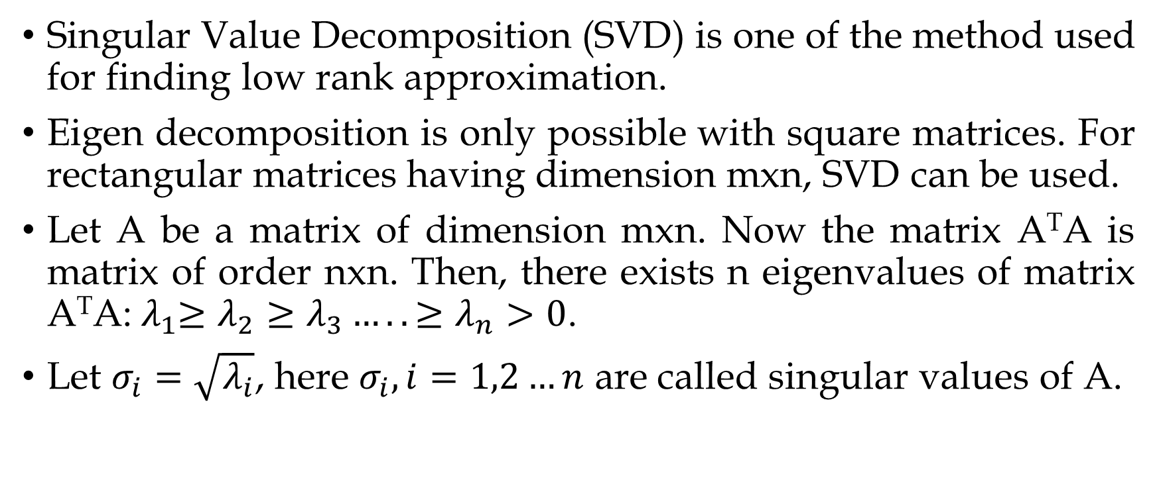
Low Rank Approximation
Singular Value Decomposition (SVD) is one of the method used for finding low rank approximation.
Eigen decomposition is only possible with square matrices. For rectangular matrices having dimension mxn, SVD can be used.
Let A be a matrix of dimension mxn. Now the matrix A^{T}A is matrix of order nxn. Then, there exists n eigenvalues of matrix A^{T}A:${ λ}_{1}≥λ_{2}≥λ_{3}…..≥λ_{n}>0$.
Let $σ_{i}=\sqrt{λ_{i}}$, here $σ_{i}, i=1,2…n$ are called singular values of A.

Slide 66
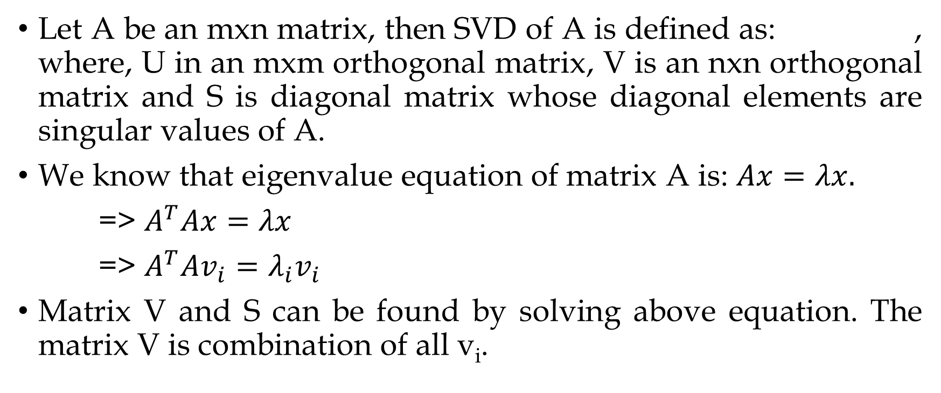
Singular Value Decomposition
Let A be an mxn matrix, then SVD of A is defined as: , where, U in an mxm orthogonal matrix, V is an nxn orthogonal matrix and S is diagonal matrix whose diagonal elements are singular values of A.
We know that eigenvalue equation of matrix A is: $Ax=λx.$
=> $A^{T}Ax=λx$
=> $A^{T}Av_{i}=λ_{i}v_{i}$
Matrix V and S can be found by solving above equation. The matrix V is combination of all v_{i}.

Slide 67
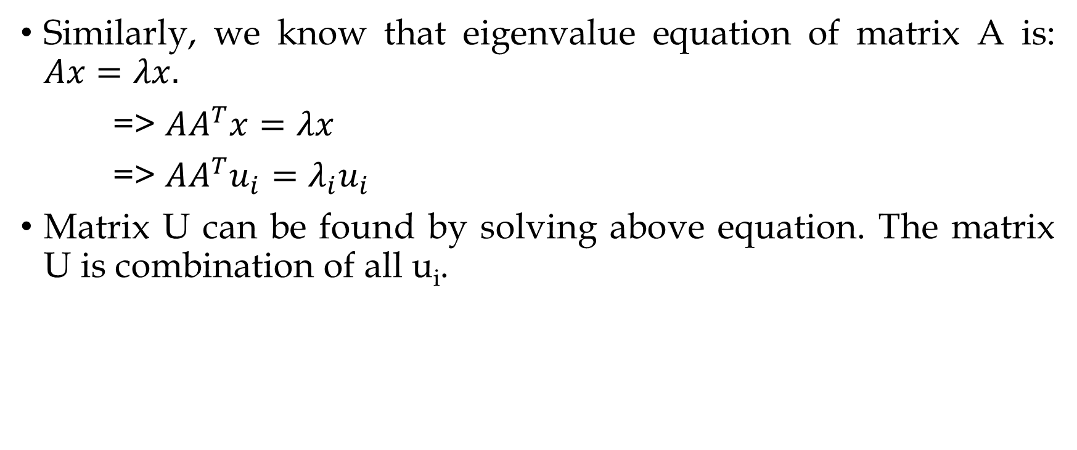
Singular Value Decomposition
Similarly, we know that eigenvalue equation of matrix A is: $Ax=λx.$
=> $AA^{T}x=λx$
=> $AA^{T}u_{i}=λ_{i}u_{i}$
Matrix U can be found by solving above equation. The matrix U is combination of all u_{i}.

Slide 68
Singular Value Decomposition
Once all factors are calculated, Set an optimization threshold (e.g., 90%). Calculate the total sum of the squares of the diagonal S matrix. Calculate how many S values it takes to reach 90% of the total sum of squares.
So if that turns out to be K S-values, then we would take the first K columns of the U matrix, first K rows of the V⊤ matrix, and a K×K square matrix out of the S matrix.
We would then calculate A=USV⊤ using the reduced matrices.

Slide 69
Singular Value Decomposition
Example: Find SVD of following matrix
Solution
Solve we get,

Slide 70
Singular Value Decomposition
Thus,
Find eigenvectors of each Eigen value
Normalized eigenvectors are:

Slide 71
Singular Value Decomposition
Thus,
Similarly, Find V

Slide 72
Factor Analysis
Factor analysis is one of the unsupervised machine learning algorithms which is used for dimensionality reduction.
This algorithm creates factors from the observed variables to represent the common variance i.e. variance due to correlation among the observed variables.
Factor analysis is a linear statistical model. It is used to explain the variance among the observed variable and condense a set of the observed variable into the unobserved variable called factors.

Slide 73
Factor Analysis
Observed variables are modeled as a linear combination of factors and error terms.
Factor or latent variable is associated with multiple observed variables, who have common patterns of responses.
Each factor explains a particular amount of variance in the observed variables. It helps in data interpretations by reducing the number of variables.
Factor analysis is a method for investigating whether a number of variables of interest x₁, x₂,……., x_{n}, are linearly related to a smaller number of unobservable factors F₁, F₂,..……, F_{k}.

Slide 74
Factor Analysis
Steps Involved in Factor
Adequacy Test
Determining the number of factors
Interpreting the factors

Slide 75
Factor Analysis
Adequacy Test
Before you perform factor analysis, you need to evaluate the factorability of the dataset.
Factorability means "can we found the factors in the dataset?". There are two methods to check the factorability or sampling adequacy:
Bartlett’s Test
Kaiser-Meyer-Olkin (KMO) Test

Slide 76
Factor Analysis
Bartlett’s test checks whether the correlation is present in the given data. It tests the null hypothesis (H0) that correlation matrix is an Identical matrix.
So, the null hypothesis assumes that no correlation is present among the variables. We want to reject this null hypothesis because factor analysis aims at explaining the common variance i.e. the variation due to correlation among the variables.
If the p test statistic value is less than 0.05, we can decide that the correlation is not an Identical matrix i.e. correlation is present among the variables with 95% confidence level.

Slide 77
Factor Analysis
Kaiser-Meyer-Olkin (KMO) Test measures the suitability of data for factor analysis.
It determines the adequacy for each observed variable and for the complete model. KMO estimates the proportion of variance among all the observed variable.
Lower proportion id more suitable for factor analysis. KMO values range between 0 and 1. Value of KMO less than 0.6 is considered inadequate.

Slide 78
Factor Analysis
Determining the number of factors
The number of factors in our dataset is equal to the number of variables in our dataset.
All the factors are not gonna provide a significant amount of useful information about the common variance among the variables.
So we have to decide the number of factors. The number of factors can be decided on the basis of the amount of common variance the factors explain.
In general, we will plot the factors and their eigenvalues. We will select the number of factors whose eigenvalues are greater than 1.

Slide 79
Factor Analysis
Interpreting the Factors
Finally, we have to interpret the factors by making use of loadings.
Loadings indicate how much a factor explains a variable. The loading score will range from -1 to 1.
Values close to -1 or 1 indicate that the factor have influence on these variables. Values close to 0 indicates that the factor has lower influencer on the variable.

Slide 80
Factor Analysis
Factor 1 has high factor loadings for E1,E2,E3,E4, and E5
Factor 2 has high factor loadings for N1,N2,N3,N4, and N5
Factor 3 has high factor loadings for C1,C2,C3,C4, and C5
Factor 4 has high factor loadings for O1,O2,O3,O4, and O5
Factor 5 has high factor loadings for A1,A2,A3,A4, and A5
Factor 6 has none of the high loadings for any variable and is not easily interpretable. Its good if we take only five factors.

Slide 81
Independent Component Analysis (ICA)
ICA assumes that each sample of data is a mixture of independent components and it aims to find these independent components. At the heart of ICA is Independence.
Suppose x, y are two random variables and their distribution functions are given by Px, Py respectively. If we receive some information about x and that doesn't change whatever knowledge we have about y, then we can say that x, y are independent variables.
Mathematically, two variables x and y are independent if the joint probability density is separable.
p(x, y) = p(x) p(y)

Slide 82
Independent Component Analysis (ICA)
Correlation only captures linear dependence. If two variables are independent then both linear and non-linear dependence will be zero.
The absence of linear dependence does not imply independence since there might be a non-linear relationship. Let's take a small example to understand this.
Suppose x=(-4,-3,-2,-1,0,1,2,3,4,) & y=(16,9,4,1,0,1,4,9,16). Correlation between x and y is zero though they have a non-linear relationship. Thus, independence between two variables implies zero correlation but it is not true in reverse.

Slide 83
Independent Component Analysis (ICA)
Suppose Alice and Bob, both are speaking at the same time. Both mics receive inputs S1 & S2 from Alice and Bob respectively. ICA assumes that the mixing process is linear i.e. it can be represented as a matrix multiplication. Each mic mixes S1 & S2 according to its location and settings which is given by a matrix A. The matrix operation produces vector M as an output. Now, you we to separate the S1 & S2 from M1 & M2. This is referred to as cocktail party problem or blind source separation.

Slide 84
Independent Component Analysis (ICA)
Let s is random vector whose elements are sources s1, s2, sn. A is a mixing matrix whose elements are aij. And x is a vector whose elements are mixtures.
Now equation for mixed sources can be written as:
x=As

Slide 85
Independent Component Analysis (ICA)
The solution to this problem is trivial if matrix A is known. A simple matrix inversion of A followed by multiplication with x will give the answer. Let W be the inverse of A then, s=Wx
But in a real-world scenario matrix A is often unknown. The only information we have is the output of the mixing process.
To solve ICA problem we make use of central limit theorem. According to the Theorem, the sum of independent random variables is more Gaussian than the independent variables.

Slide 86
Independent Component Analysis (ICA)
ICA Algorithm
At a high level, ICA can be broken down into the following steps.
Center x by subtracting the mean
Whiten x
Choose a random initial value for the de-mixing matrix w
Calculate the new value for w
Normalize w
Check whether algorithm has converged and if it hasn’t, return to step 4
Take the dot product of w and x to get the independent source signals

Slide 87
Independent Component Analysis (ICA)
Whitening
To “whiten” a given signal means that we transform it in such a way that potential correlations between its components are removed (covariance equal to 0) and the variance of each component is equal to 1. Another way of looking at it is that the covariance matrix of the whitened signal will be equal to identity matrix.
The actual way we set about whitening a signal involves the Eigen-value decomposition of its covariance matrix.

Slide 88
Independent Component Analysis (ICA)
The corresponding mathematical equation can be described as follows.
x=ED⁻¹E^{T}x
where D is a diagonal matrix of eigenvalues (every lambda is an eigenvalue of the covariance matrix)

Slide 89
Independent Component Analysis (ICA)
Example: Whiten following matrix

Slide 90
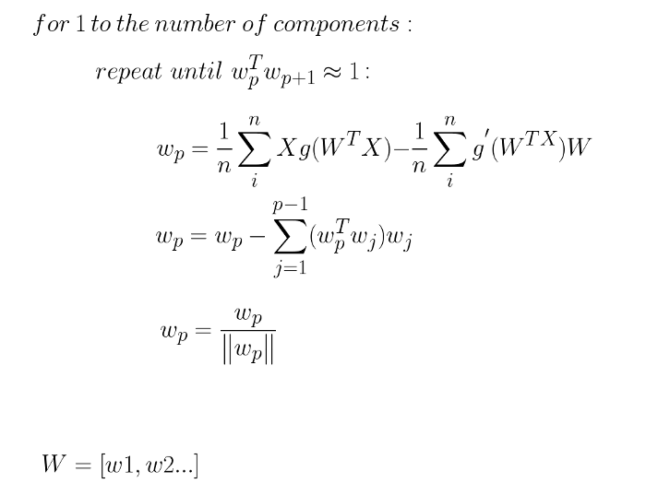
Independent Component Analysis (ICA)

Slide 91
Latent Semantic Indexing
Latent semantic indexing (LSI) or latent semantic analysis (LSA) is dimensionality reduction used in natural language processing.
LSA assumes that words that are close in meaning will occur in similar pieces of text.
A matrix containing word counts per document or documents of tf-idf scores is constructed from a large piece of text and SVD is used to reduce the number of rows while preserving the similarity structure among columns.

